Slide 1
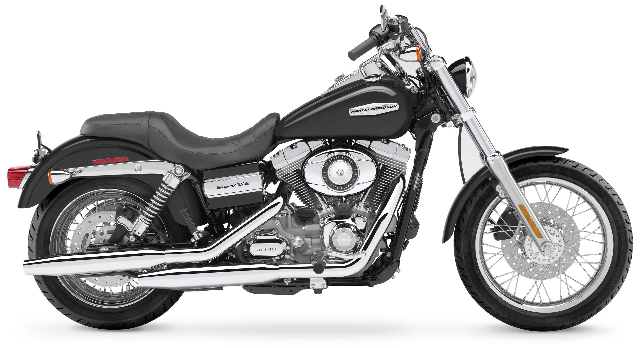
SMART RIDE

Slide 2
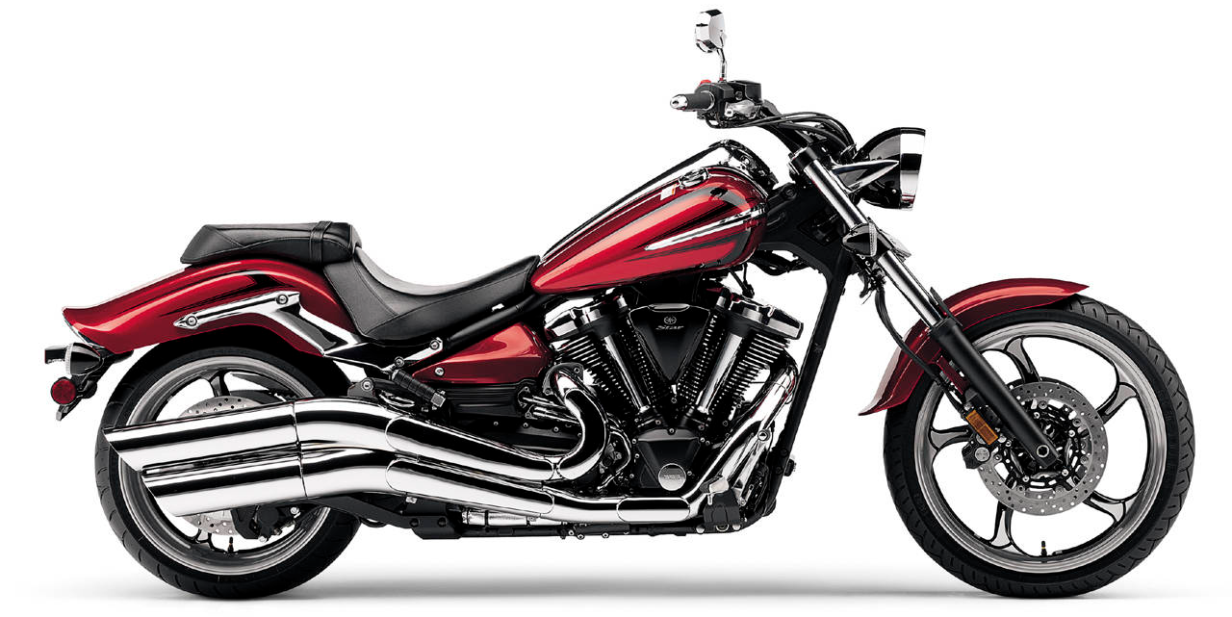
THE WIND IN YOUR FACE
THE DUSTY ROAD
YOUR BIKE
YOU
THE CONNECTION IS DEEP

Slide 3
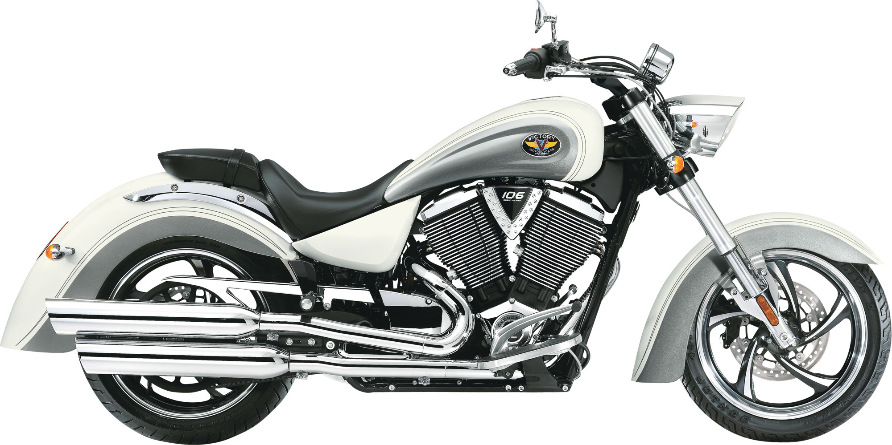
WITH
SMART RIDE
THE CONNECTION GETS
BETTER

Slide 4
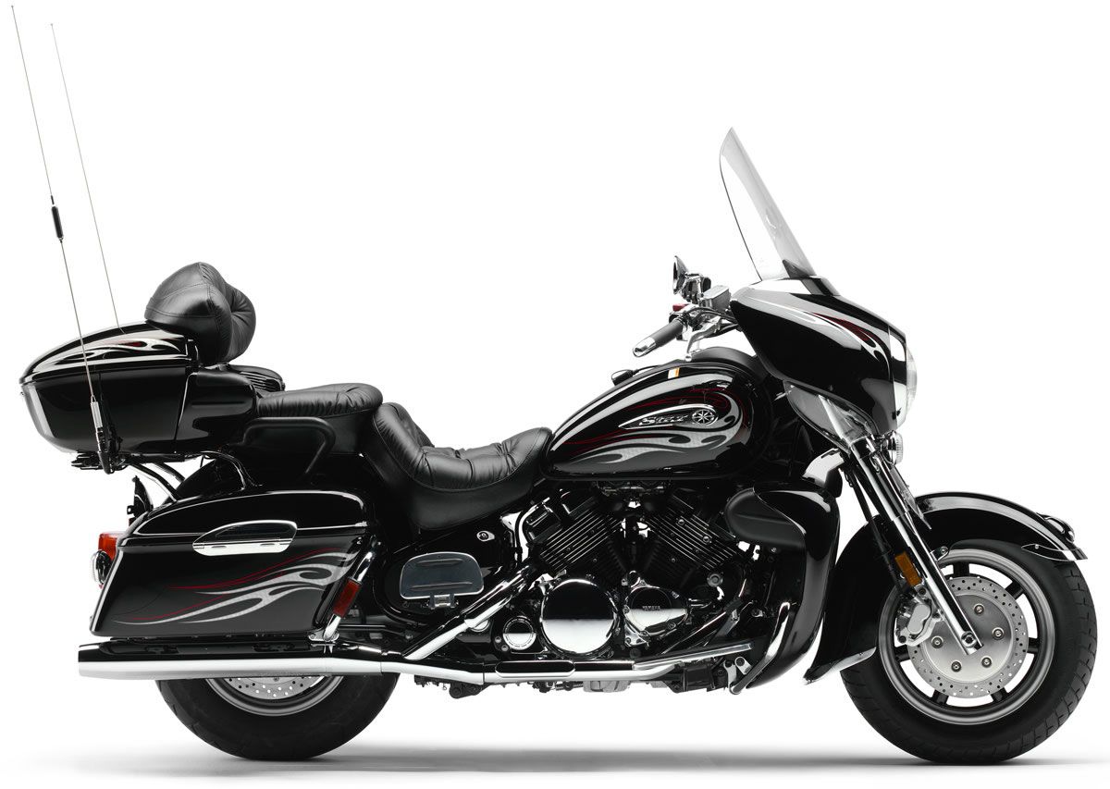
SENSORS: TEMPERATURE, PRESSURE, PROXIMITY, WEIGHT, SPEED, … MOUNTED CAMERA, ACTUATORS, …

Slide 5







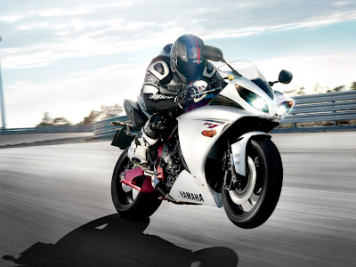
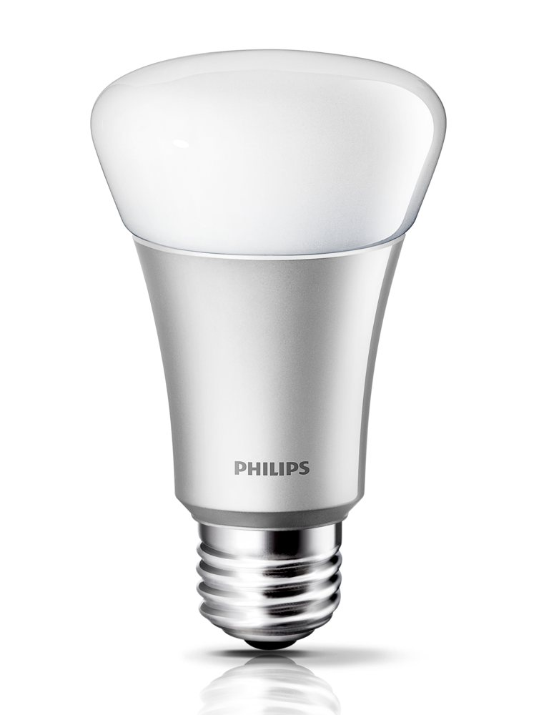

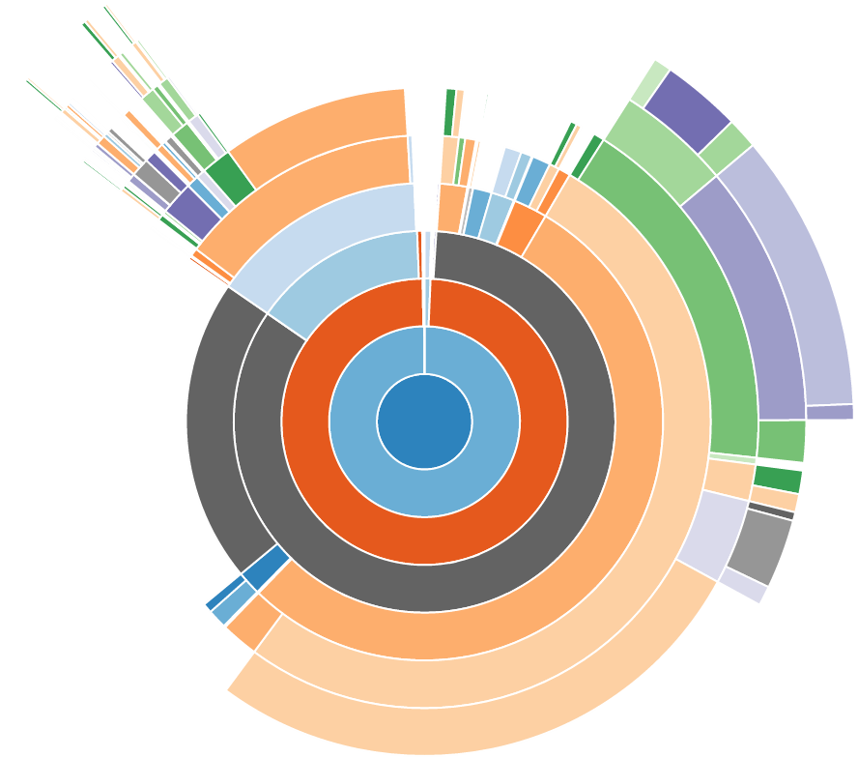



THE TECHNOLOGY STACK
sensing
viewing
actuating
d3js

Slide 6
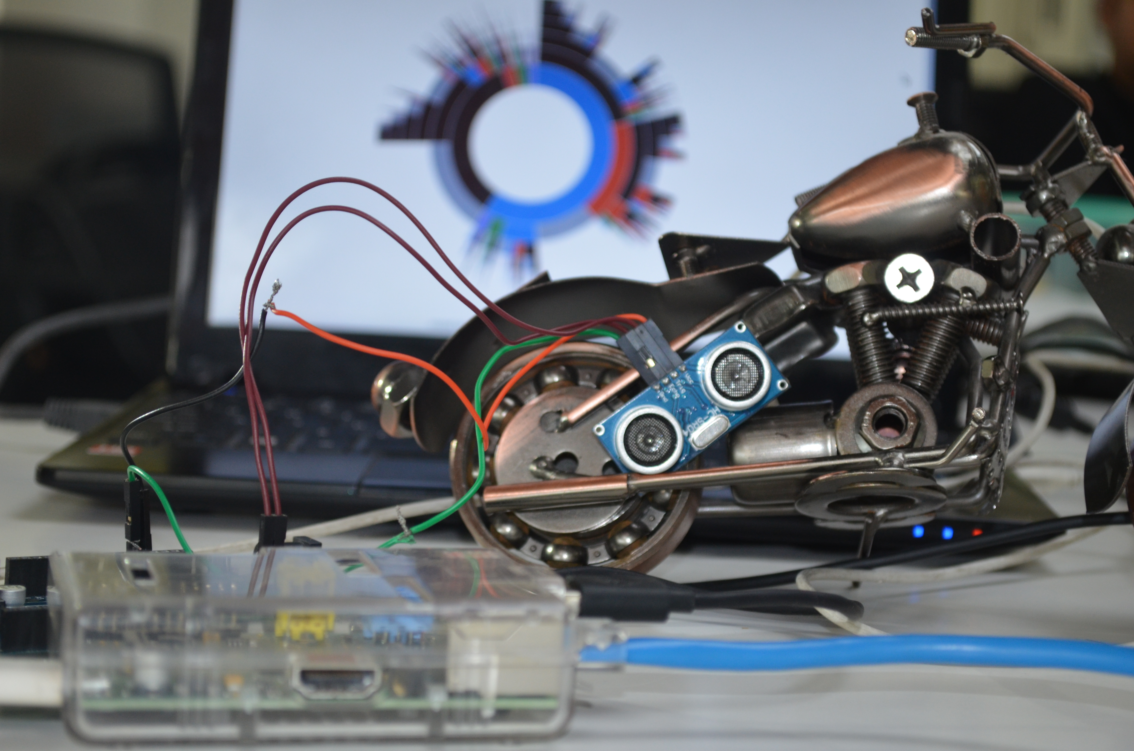

Slide 7
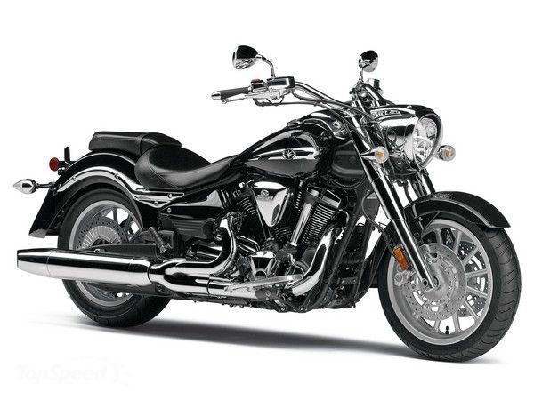

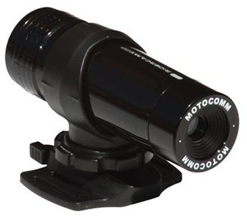
RIDERS GO WHERE OTHERS CAN’T
SMART RIDE MAPS UNCHARTERED TERRAIN

Slide 8
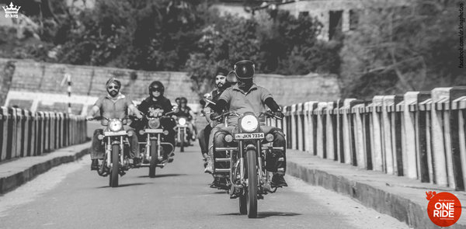
SPONSORED RIDES COLLECTS USAGE INFO

Slide 9
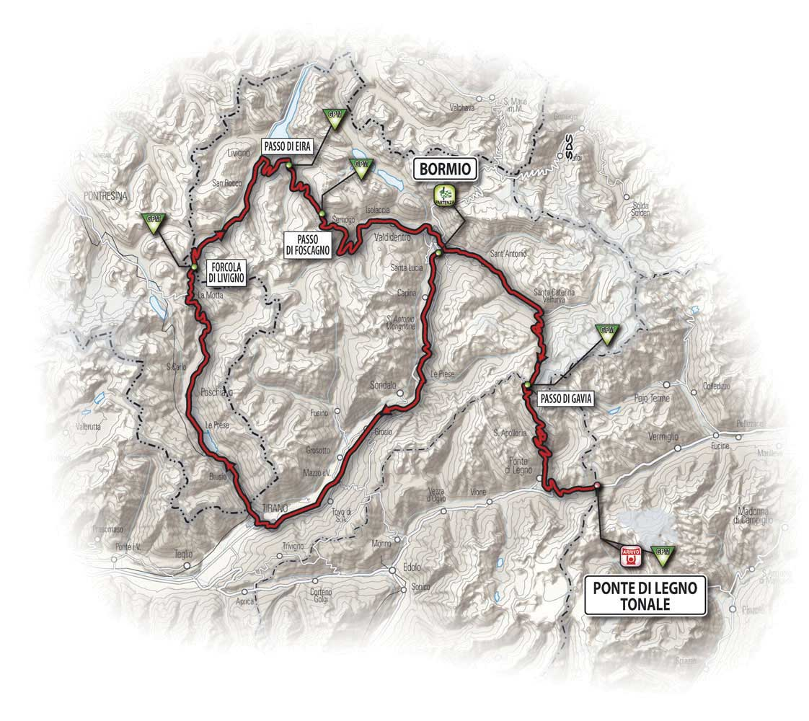

PICK UP ITEMS AT STORES ALONG THE WAY

Slide 10


BIKE PERFORMANCE CORRELATED WITH CLIMATE CONDITIONS

Slide 11
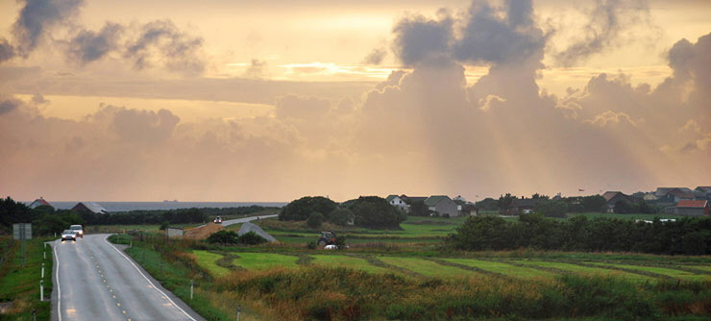

DISCOVER PLACES ALONG THE RIDE

Slide 12





https://github.com/sathishvj/smartrides
Deepak Mittal
Mohith Prabhu
Sathish VJ
d3js

Slide 13
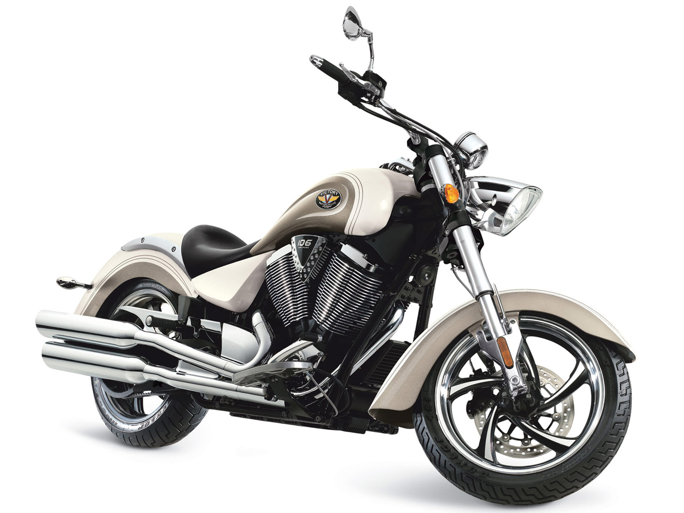
SMART RIDE

